Slide 1
Northwind Analysis & Insights

Slide 2



Let's Dive!
Trends
Analysis
Insights

Slide 3
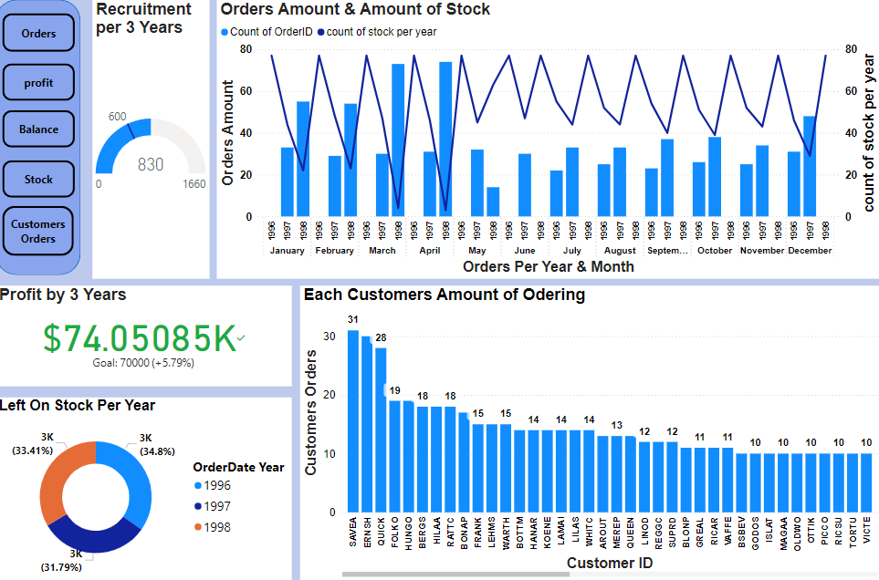
Northwind KPI Dashboard

Slide 4
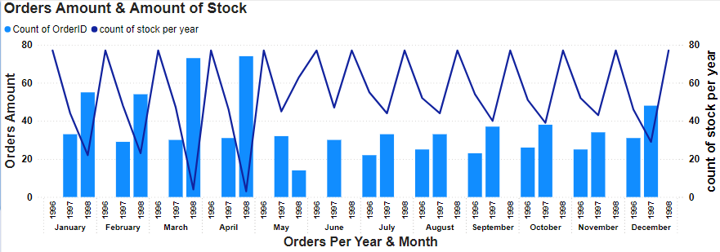
Analysis and Insights
Order and Stock Trends (1996-1998)
Order Volume Increase
From 1996 to 1998, the data shows a significant upward trend in the number of orders:
July 1996: Average of 25 orders.
1997: Increased to 34 orders.
1998: Further rose to 54 orders, marking a 116% increase over the two years.
Peak and Stock Levels
In April 1998, orders peaked at 74, leading to stock levels dropping to only 3 products. This surge was likely due to successful social media campaigns.
Inflation Impact
In May 1998, orders dropped by 14, likely due to rising inflation, which affected customer spending.

Slide 5
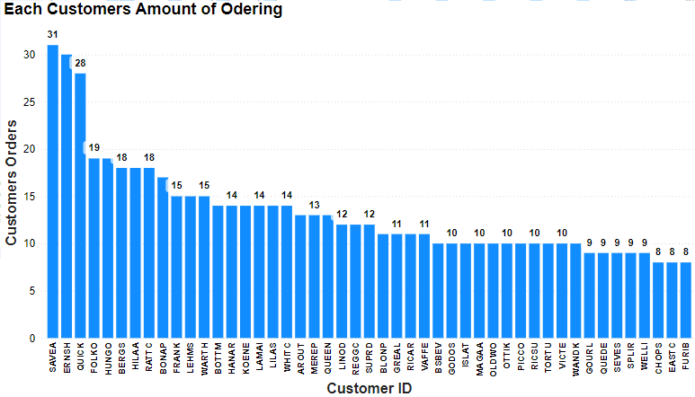
Analysis and Insights
Top Customer by Orders
SAVEA- This customer made the highest number of orders, totaling 31.
ERENSH- Following closely, with 28 orders.
Last Customers by Orders
FURIB,EASTC,CHOPS- This customer made the lowest number of orders, totaling 31.
Order Distribution
There's a noticeable drop in the number of orders after the top few customers.
Insights
Identifying patterns among the top customers can help improve business strategies.
Enhancing engagement with customers who have lower order counts may boost overall sales.

Slide 6
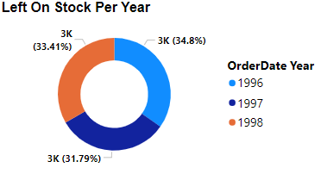
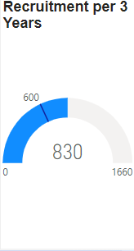
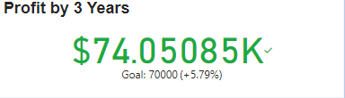
Stock Amount per 3 Years
1996 – The amount of left on stock stands on 3K products which is 34.8%.
1997 – The amount of left on stock stands on 3K products which is 31.79%.
1998 – The amount of left on stock stands on 3K products which is 33.41%.
insights
In 1996, the stock left amount was 34.8% due to fewer orders at the company's inception.
A sharp decrease in stock occurred as orders increased, which is evident in the Order Amount Chart.
Employees Recruitment per 3 Years
Our goal with 3 years to recruit 600 employees and we recruited an 830.
Insights
The company has surpassed its recruitment and profit goals, achieving a workforce of 830 employees and generating a profit of $74,000.

Slide 7
Thank You !
Git URL
Project GitHub URL
KPI Dashboard GitHub URL

